Slide 1
COMM 2293:
Business Communications
Section F
Prof. Emily Ballantyne
7 February 2019 – Persuasion 2: AIDA

Slide 2
Agenda
AIDA
Paraphrasing Sources
Writing Signal Phrases
Modifiers

Slide 3

Graphics Homework
DUE DATE: FRIDAY FEBRUARY 8th
Graphics

Slide 4

Next class is a Workshop.

Slide 5
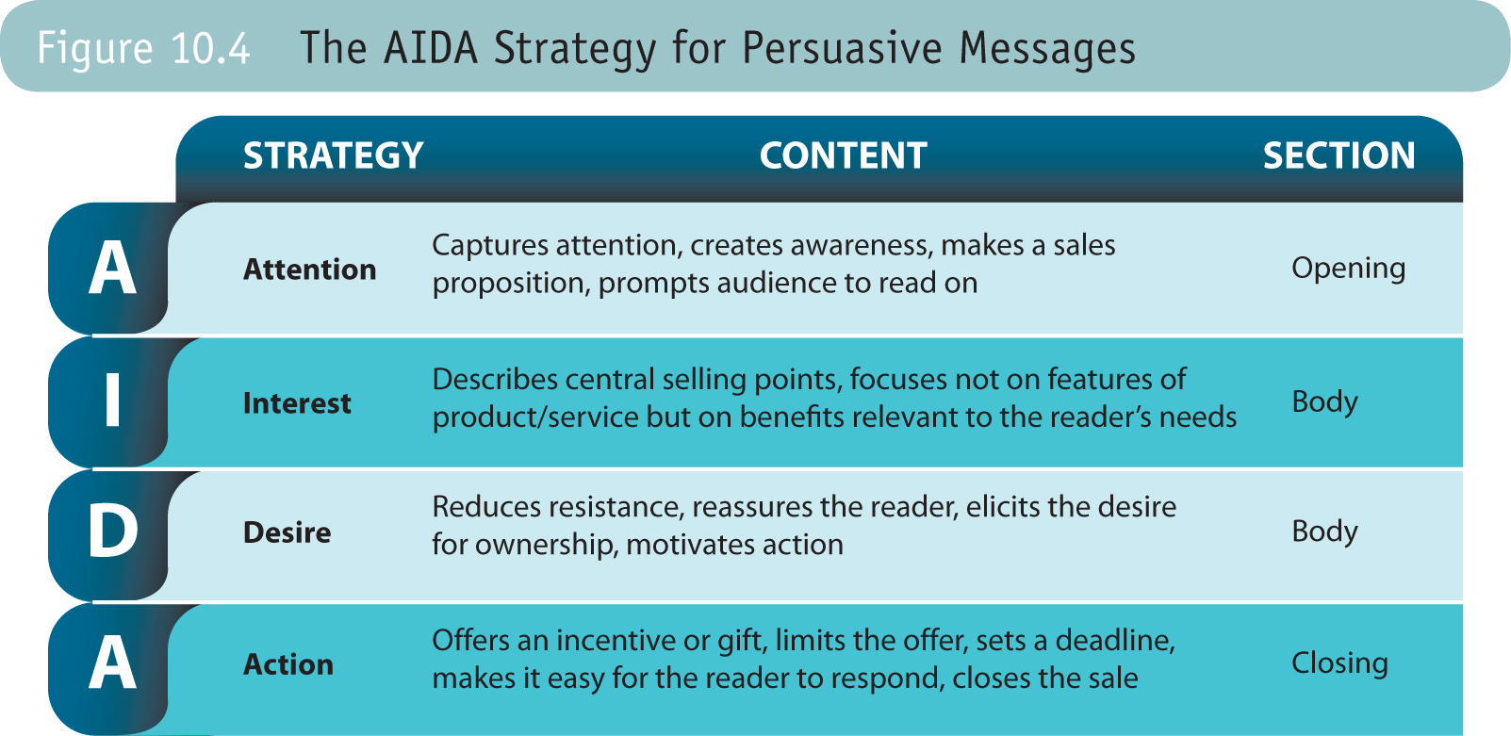
AIDA for Persuasion

Slide 6
Persuasion Strategy Basics
Problem
Solution

Slide 7
Indirect Strategy
1) Attention – Get your reader’s attention and state the problem.
2) Interest – Identify main points and reader benefits
3) Desire – Anticipate and overcome objections
4) Action- state your purpose and desired outcome

Slide 8
Your Persuasive Facts
What did you learn by looking at the research materials on Brightspace?
Where should that information appear in your report?

Slide 9
Attention
Introduce your topic with:
  A problem
  An unexpected statement
  A reader benefit
  A compliment
  A related fact
  A stimulating question

Slide 10
Interest
Build interest with:
  Facts
  Figures
  Expert opinions
  Examples
  Specific details
  Direct benefits
  Indirect benefits

Slide 11
Interest
Establish your credibility
  What sources did you use?
  What does your position in the industry allow you to see/understand about the problem to be solved?
  What experience do you bring to your request?

Slide 12
Reader Benefits
Why should it matter to them?
Why should they act?
What’s in it for them?
What’s in it for you?
Who cares about this?

Slide 13
Direct and Indirect Benefits
Direct Benefits
Indirect Benefits
More immediate and tangible benefits tied to an individual or a company’s interests
Some examples are increasing profit, maximizing efficiency, improving customer satisfaction
Less tangible concepts that are related to goodwill and reputation in a profession or broader community
Some examples are: improving the community, contributing to the profession, or helping the environment

Slide 14
How do you create desire?
Reduce resistance
Anticipate objections
Offering counterarguments
Using what if? scenarios
Demonstrate competence
Show the value of your proposal

Slide 15
Anticipate Objections
Identify the audience’s objections:
Plastic bags are inexpensive.
Plastic bags are convenient.
The by-law won’t go into effect until 2020.

Slide 16
Create Counter Arguments
Identify the audience’s objections and prepare proper counter arguments that emphasize benefits:
Plastic bags are inexpensive.
  Counter: If customers bring their own bags, it costs us nothing. If they forget to bring bags, we can charge them for more expensive cloth bags, increasing our profit.
Plastic bags are convenient.
  Counter:
The by-law won’t go into effect until 2020.
  Counter:

Slide 17
Reduce Reader Resistance
Put the objection in a subordinate clause that is answered by the counter objection
Use a subordinating conjunctions to introduce the objection: while, although, even though, since, though, unless, whether, whereas, until
Use tentative language to describe the possible negative outcome: may, possibly, could, seems

Slide 18
Creating Desire Examples
Although paper bags may cost more, they are less likely to break.
While eliminating bags could cause customers to shop elsewhere, it could also bring in new customers who want to support the environment, and it could save us money.

Slide 19
Close with Action
Describe a specific request
Sound confident
Make the action easy to take
Offer an incentive or gift
Offer no excuses
Repeat the main benefits

Slide 20
Action
Suggest specific and easy-to-follow action with a deadline and reason for the date.
Don’t sound apologetic or supply excuses.

Slide 21
What is the main action required in Assignment 3?
The close is where you state your main purpose. This is when you say what you want your reader to do.

Slide 22
Summary, Paraphrase and Quotation
Summary
  Useful for condensing a lot of material into a short amount of space
Paraphrase
  Useful for communicating someone else’s ideas in your own words to relay the most important information
Quotation
  Useful for sampling the language or style of someone else’s prose

Slide 23
Paraphrasing
Put someone else’s ideas into your own words
Provide a reference to show where the idea came from

Slide 24
How to Paraphrase
Read the original passage as many times as you need to in order to understand it thoroughly.
Set it aside and write your paraphrase.
Check your paraphrase against the original to make sure you have accurately expressed the original’s meaning.
Use quotation marks for any term or phrase you have borrowed.
Record the source (author, title, page) for future use.
http://owl.english.purdue.edu/owl/resource/563/02/

Slide 25
Signal Phrases
Put the author and the year of publication into your sentence followed by a verb.
e.g. Guffey et al (2019) suggest that after you write your paraphrase, you should also check to see if the grammatical structure you use is different. This means you can’t just swap out one word for another.
Some Signal Phrases: adds, admits, agrees, argues, claims, comments, compares, demonstrates, illustrates, implies, insists, notes, reasons, says, states, suggests

Slide 26

Modifiers

Slide 27
Modifiers
As a business professional, my messages should be clean, clear and precise.
As a business professional, I should write clean, clear, and precise messages.

Slide 28
Next class is Workshop.

Slide 29
For Tuesday
Assignment 3 Workshop
Read: Assignment 3 draft
Review: AIDA
Research on plastic bags
Assignment 3 draft
Write: draft of Assignment 3

